Slide 1
Instance-Based Methods and Nearest Sequence Memory Learning
AINT351 Machine Learning

Slide 2
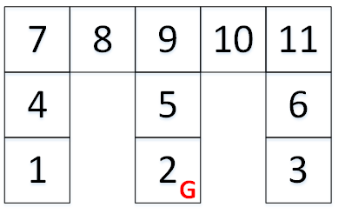
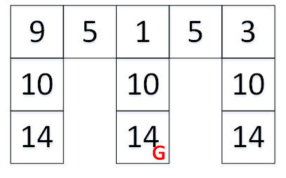
Limited Sensors in a Grid World
Encode what walls are present
Add up the present walls
North 1, East 2, South 4, West 8
States Observations

Slide 3
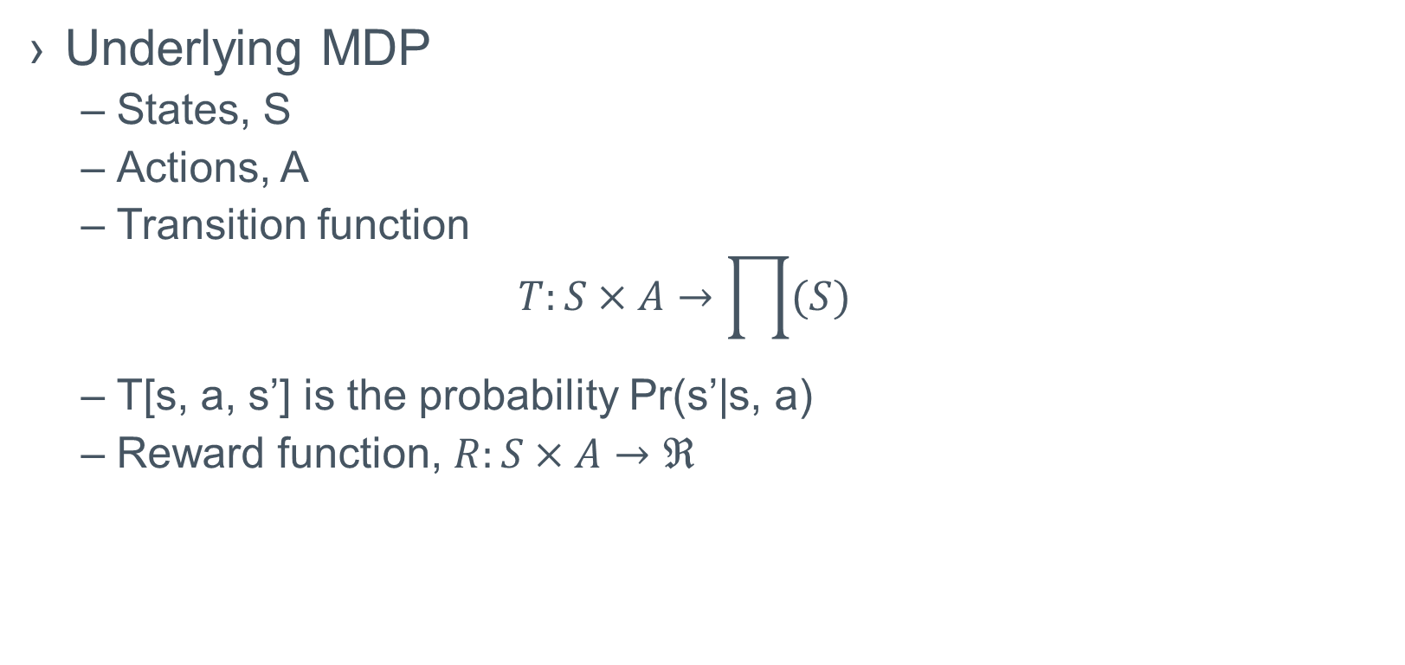
POMDP Formalisation
Underlying MDP
States, S
Actions, A
Transition function
$$T:S×A→\prod{(S)}$$
T[s, a, s’] is the probability Pr(s’|s, a)
Reward function, $R:S×A→ℜ$

Slide 4
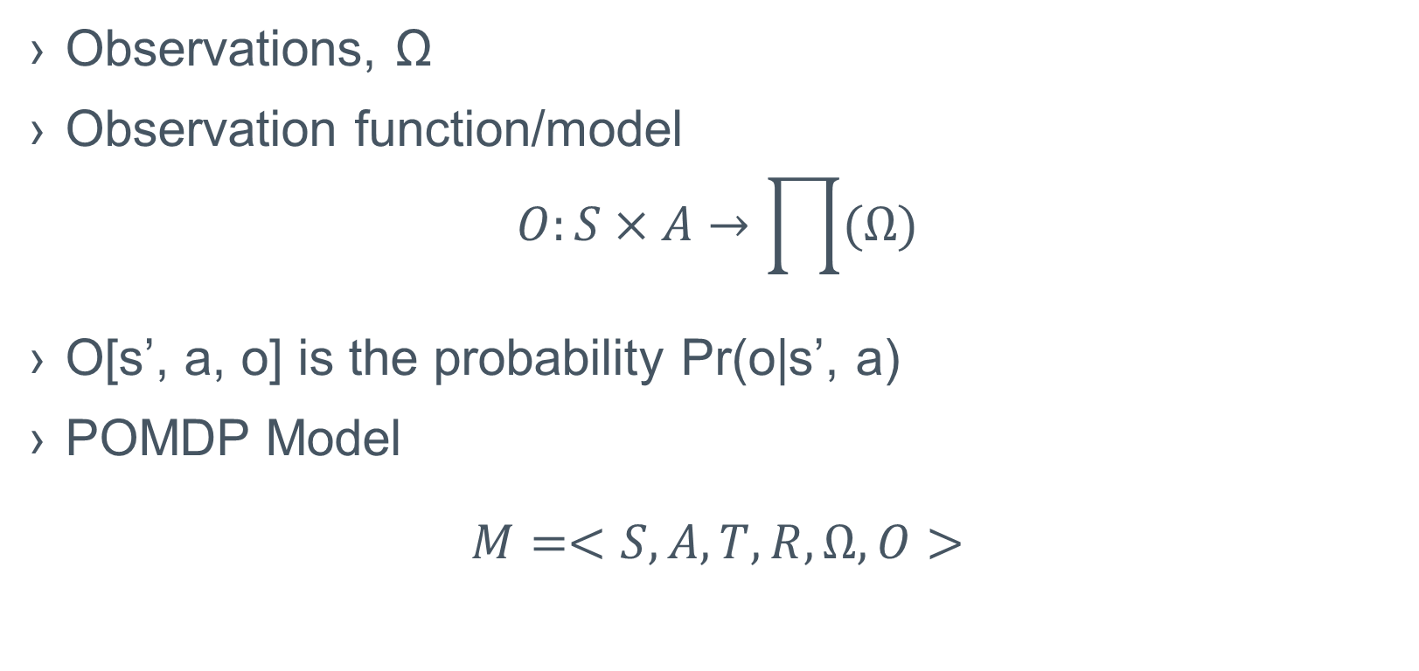
Limited Observability
Observations, Ω
Observation function/model
$$O:S×A→\prod{(Ω)}$$
O[s’, a, o] is the probability Pr(o|s’, a)
POMDP Model
$$M=<S, A, T, R, Ω,O>$$

Slide 5
Instance-Based Methods
Do not construct a theory
Does classification/regression from the raw data each time
Complexity is limited by the size of the training set

Slide 6
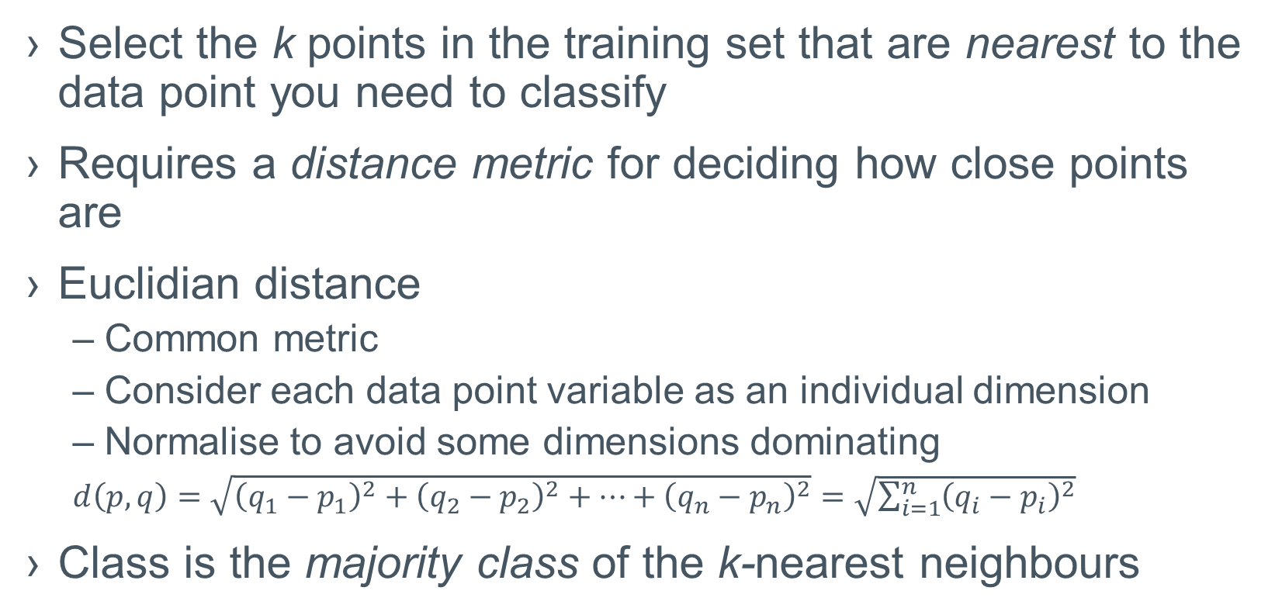
K-Nearest Neighbour Learning
Select the k points in the training set that are nearest to the data point you need to classify
Requires a distance metric for deciding how close points are
Euclidian distance
Common metric
Consider each data point variable as an individual dimension
Normalise to avoid some dimensions dominating
$d\left(p,q\right)=\sqrt{{\left(q_{1}−p_{1}\right)}^{2}+{\left(q_{2}−p_{2}\right)}^{2}+…+{\left(q_{n}−p_{n}\right)}^{2}}=\sqrt{\sum_{i=1}^{n}{{\left(q_{i}−p_{i}\right)}^{2}}}$
Class is the majority class of the k-nearest neighbours

Slide 7
Instance-Based Solutions
Nearest Sequence Memory
Keep current episode in STM
Remember last N episodes (instances) in LTM
Match STM and LTM (k-nearest neighbours)
Calculate highest value action
Can learn very quickly
Potentially one-shot
Fixed memory requirements
Can forget solutions

Slide 8
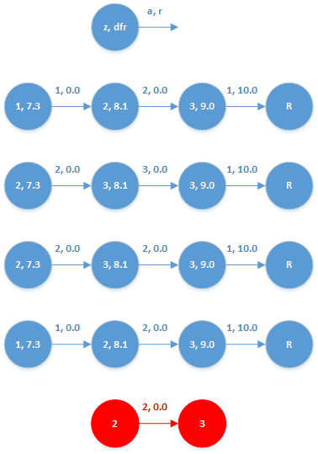
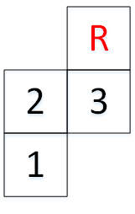
Nearest Sequence Memory

Slide 9
Compared to Belief-State Solutions
Belief-State LTM
Transition Function
Observation Function
STM
Belief State
NSM belief state is implicit in the k-nearest sequences

